Slide 1

BLACK OWN BUSINESS
(BOB)
CHALLENGE
Sisterhood Committee
Co Chairs:
Anika McCready & Chantel Washington

Slide 2
Objective
The objective of the BOB (Black Owned Business Challenge) was to dedicate a month of your effort and time along with your fellow Sorors, towards building the economic wealth in our community in order to promote positive social change
…and establish a spirit of ongoing support beyond the month of March.

Slide 3
Teams Must
Teams Must…
Have no more than 8-10 members on a team
All members must participate throughout the challenge with a minimum of 5 people being present at each “location”
A social review of each establishment visited/supported (Facebook, Twitter, Instagram, Yelp, BBB, Angie’s List, etc.)
Proof of visitation and support through receipts, pictures…
A submission of places visited along with a “write-up” of the overall experience.

Slide 4
Team Share the Love

Slide 5
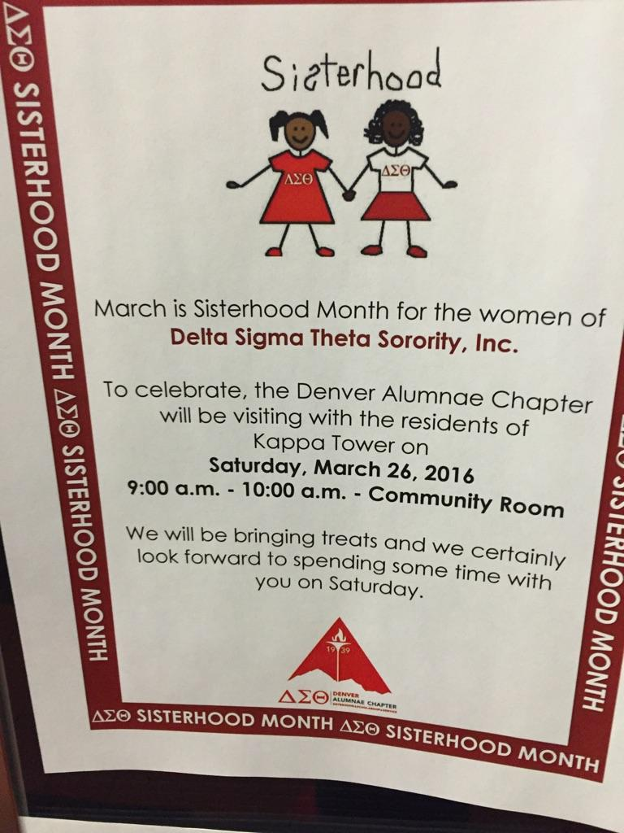
Bob – Kappa Towers

Slide 6
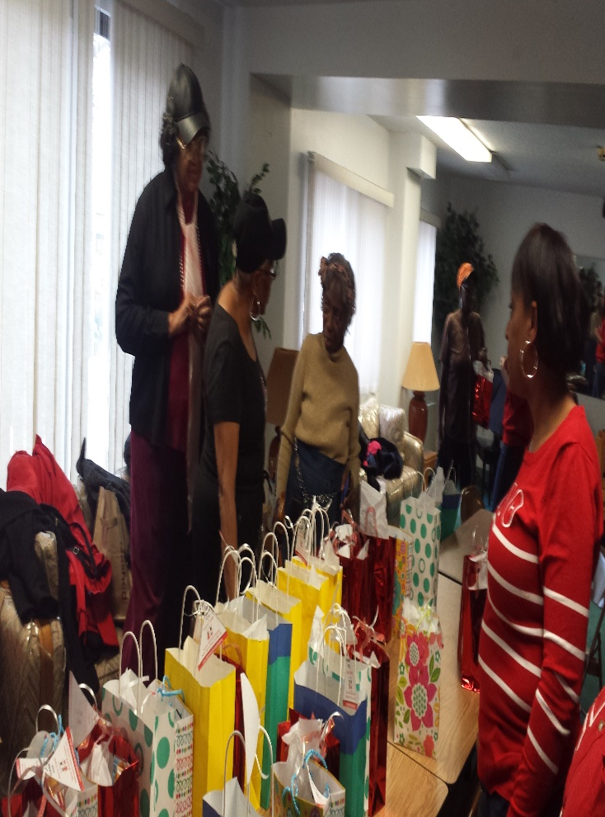
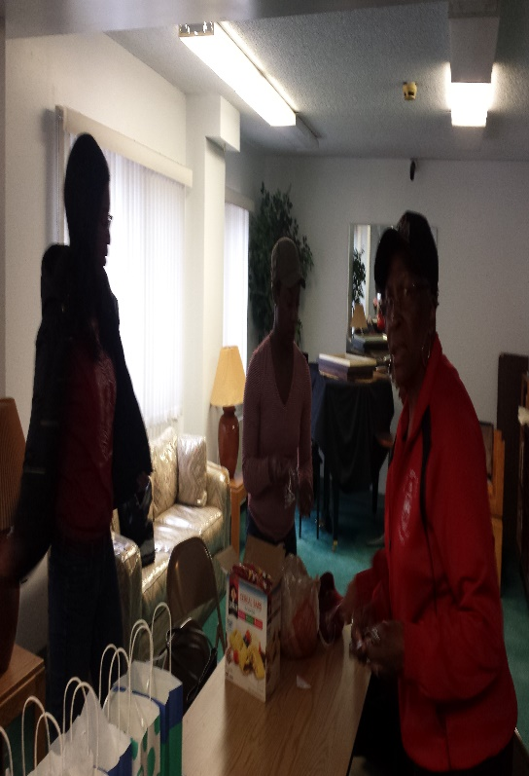
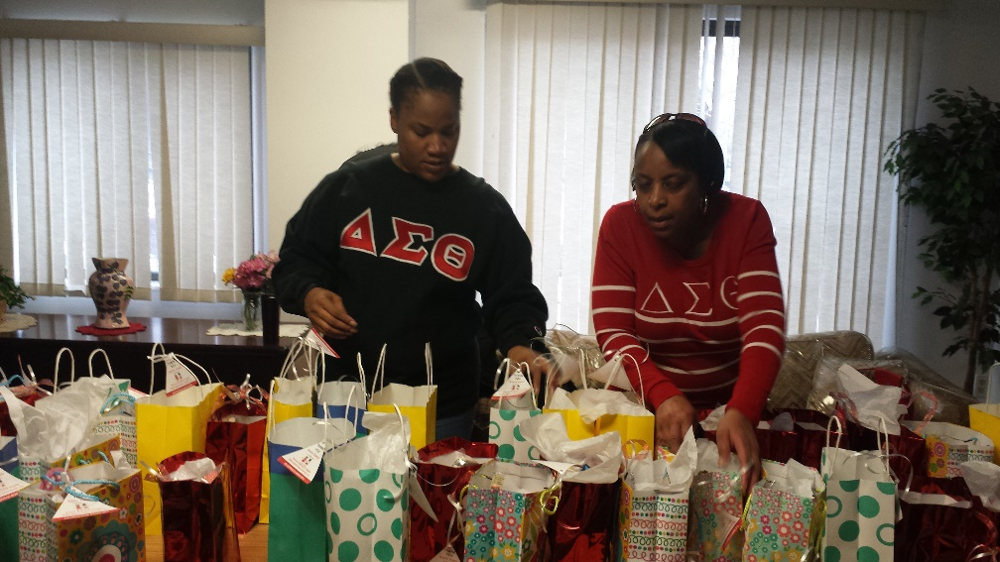
Sharing Love bags with the residents

Slide 7
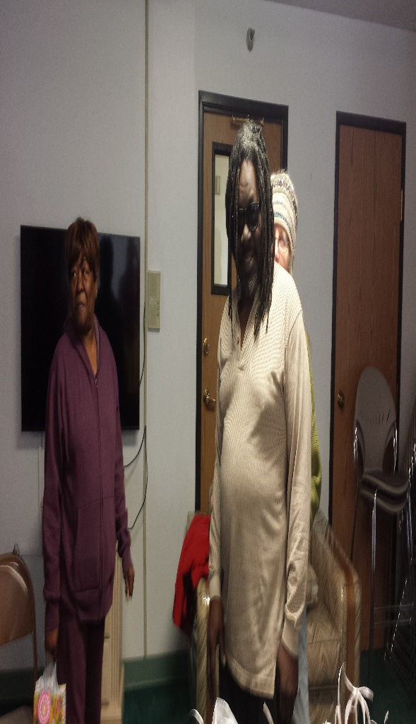
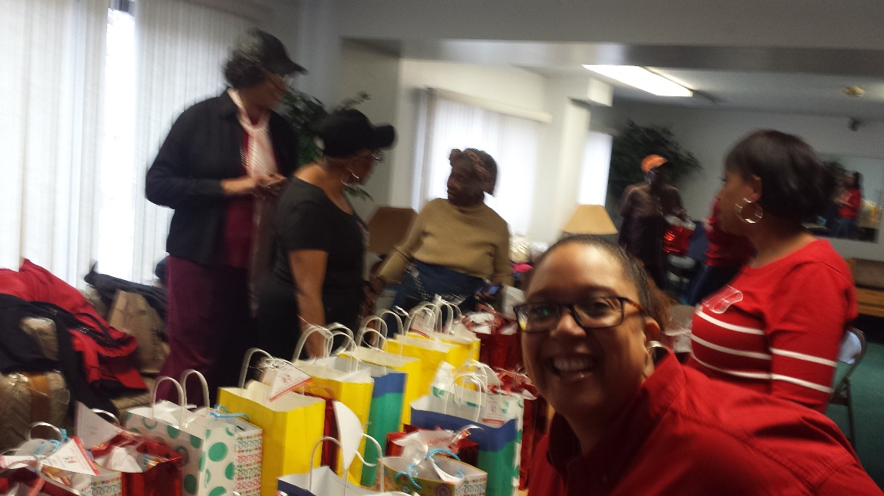
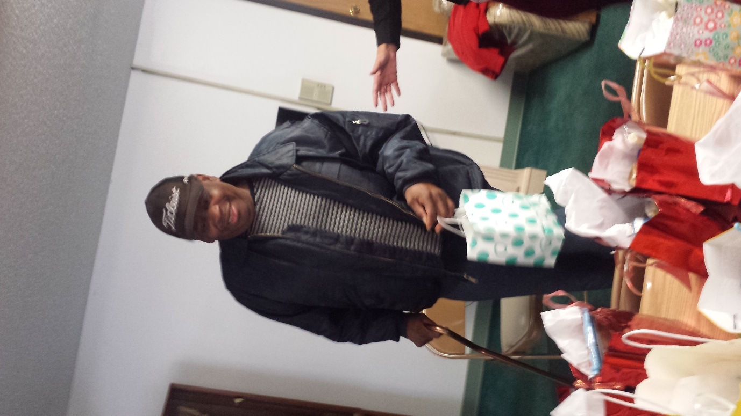

Slide 8
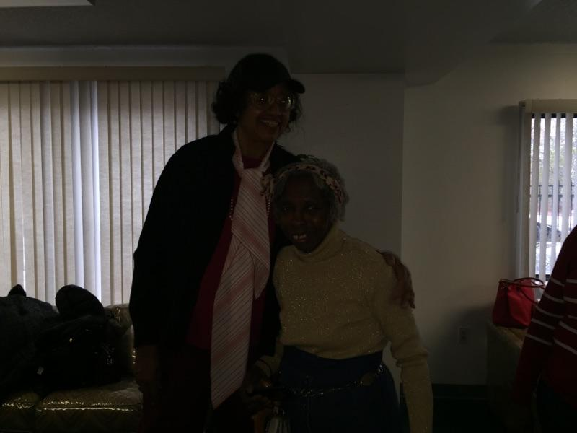
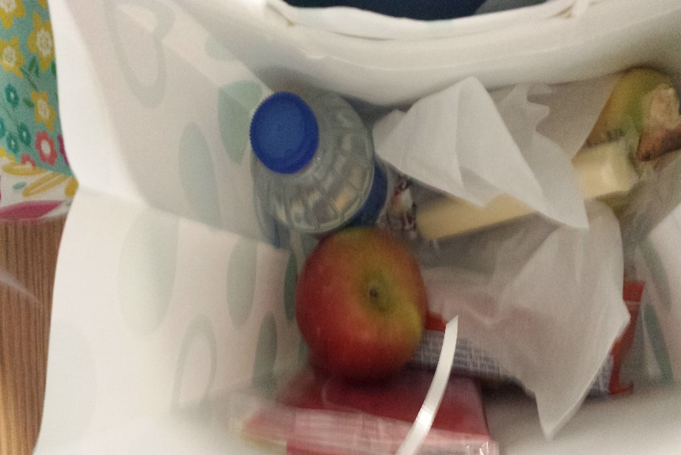
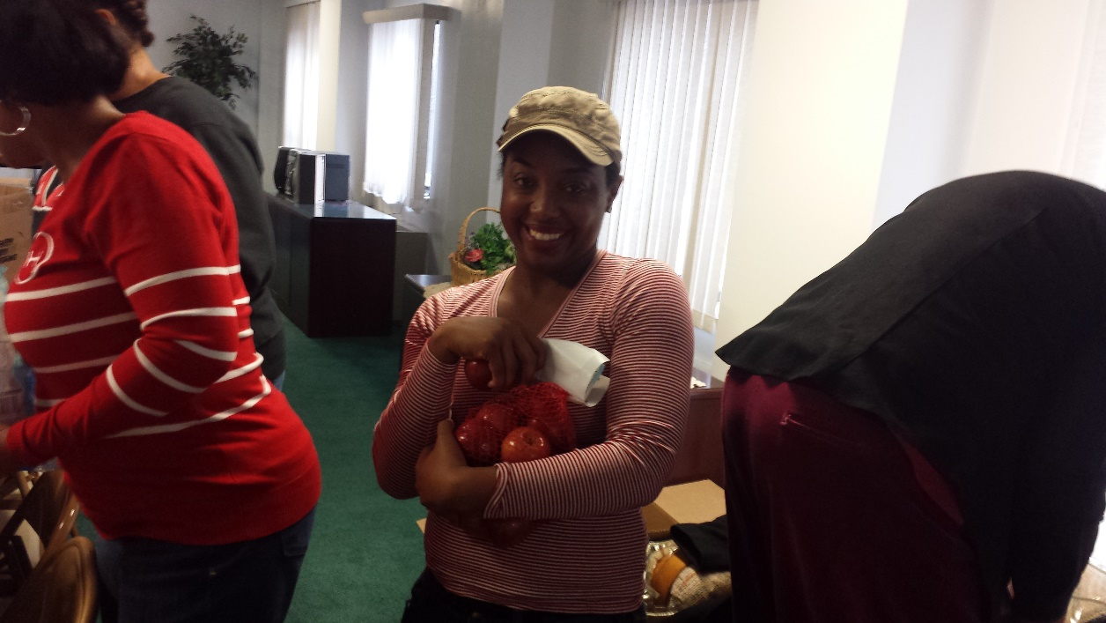
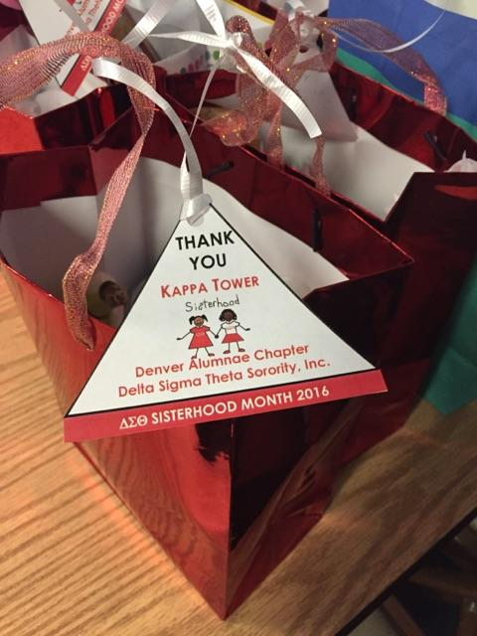
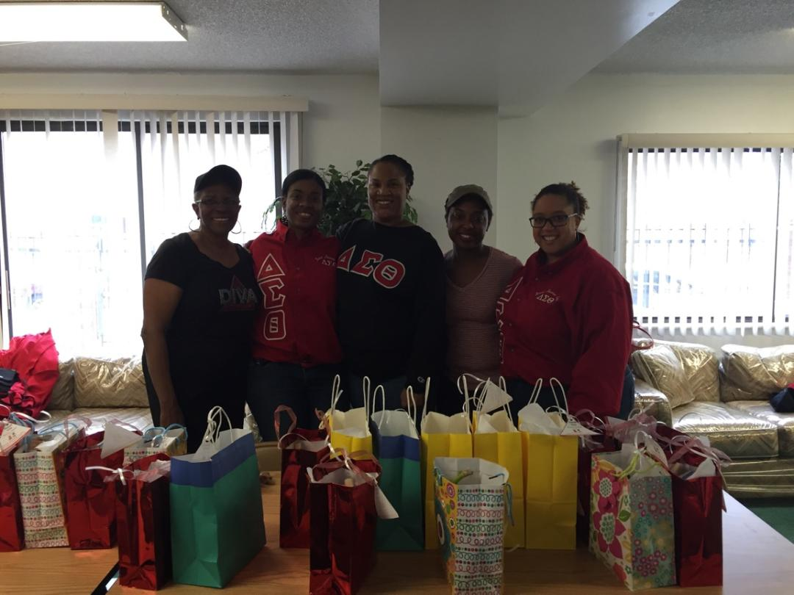

Slide 9
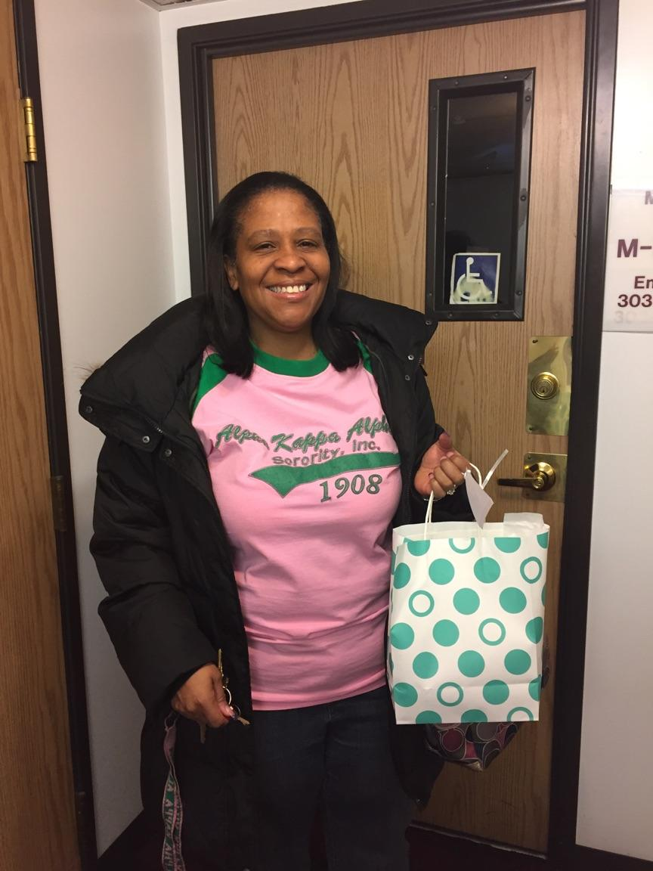
We made bags for the staff of Kappa Towers as well…

Slide 10
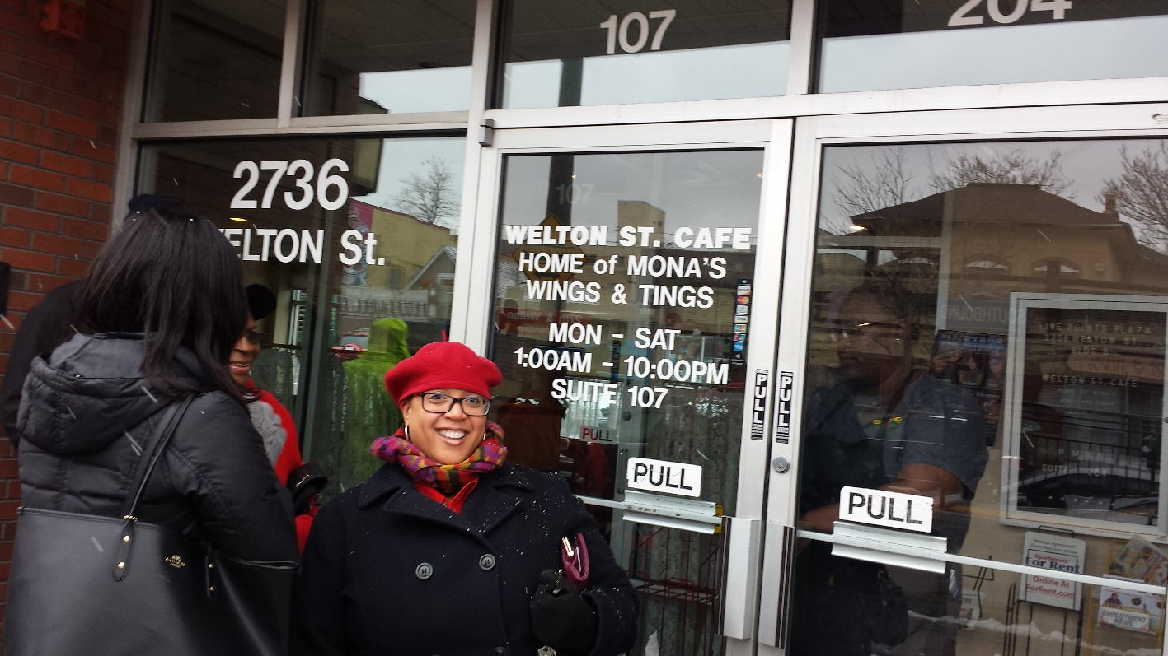
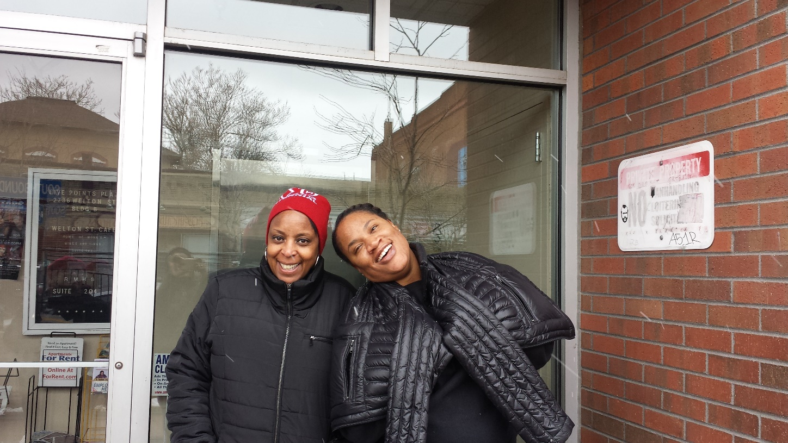
BOB – Welton St Cafe

Slide 11
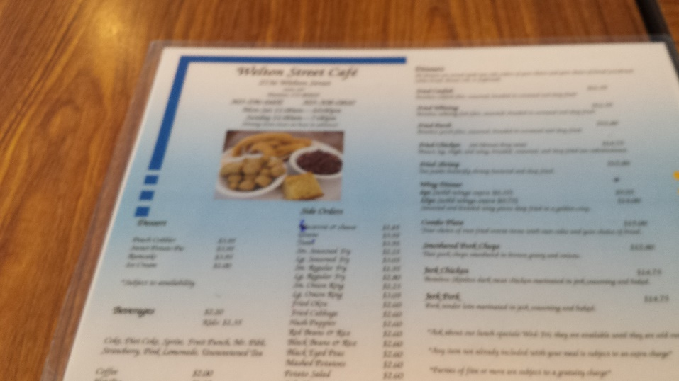
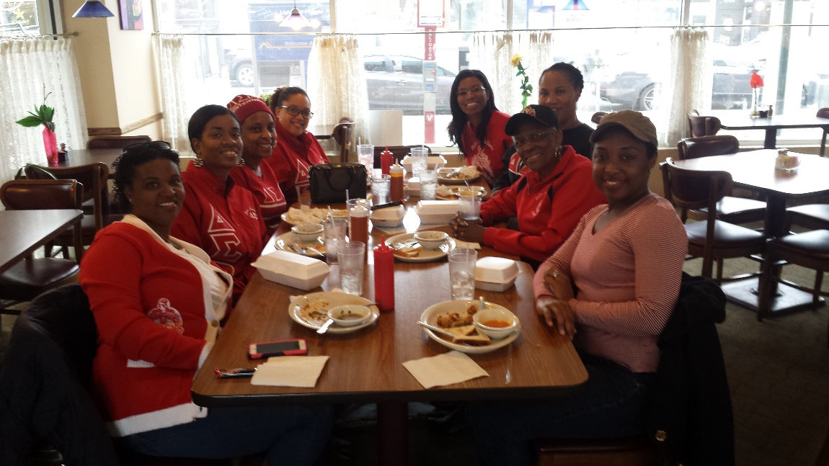
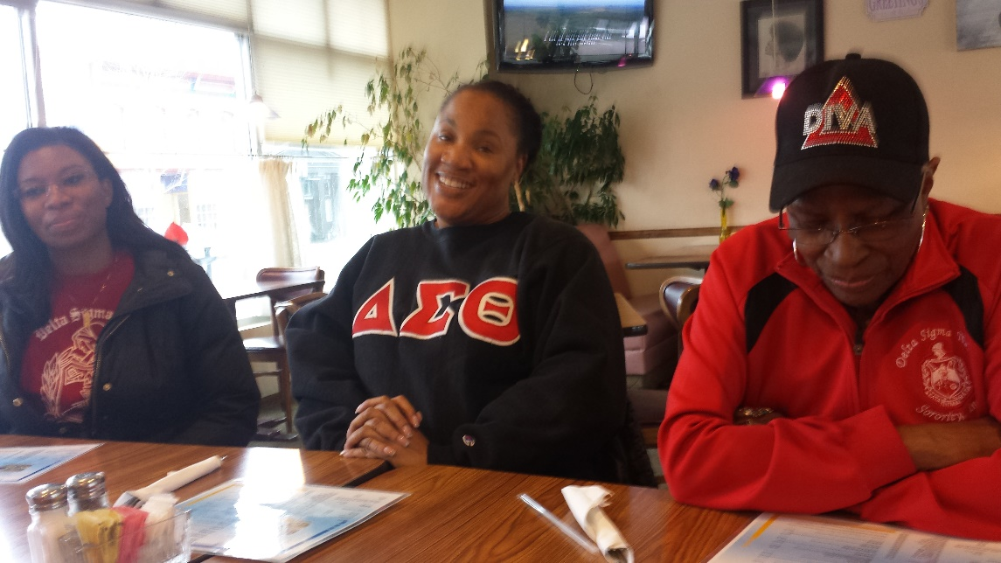
The Food was Awesome and so was the sisterly Fellowship

Slide 12
Final Write Up
Our experience at Kappa towers was great. The residents were real friendly and very appreciative of us greeting them with goodie love bags. The facility is very nice and everyone there seemed to be in great spirits.
Welton ST Café didn’t let anyone down. Everyone enjoyed their meal and the sisterhood time. For those that had never been, they stated that they would come back and bring their family.
Pictures were posted on Deon’s Instagram account the day after the events, and Yelp reviews were submitted as well.

Slide 13
Team Matthews:
Supported two black businesses in the community while fellowshipping during sisterhood month.
Enjoyed Oolong tea and lavender vanilla scones purchased from Nana's Gourmet Market and Tea Emporium in Denver,
Purchased and prepared "Thinking of You" cards from Cards by Bruton for our Delta sisters who are sick and shut in.
Additionally, three of our Delta Sisters on the team who are entrepreneurs shared aspects of starting their businesses, goals for the next 5 years and what inspires them: Michelle Brown - Cards by Bruton, Crystal Vann-Mary Kay Consultant and Dr. Roechelle Smith - Prolific Chiropractic, P.C.
Members:
Mary Matthews (Team Captain)
Ronnette' Harris
Dorothy White
Alexis Williams
Michelle Brown
Roechelle Smith
Catherine Wright
Crystal Vann

Slide 15
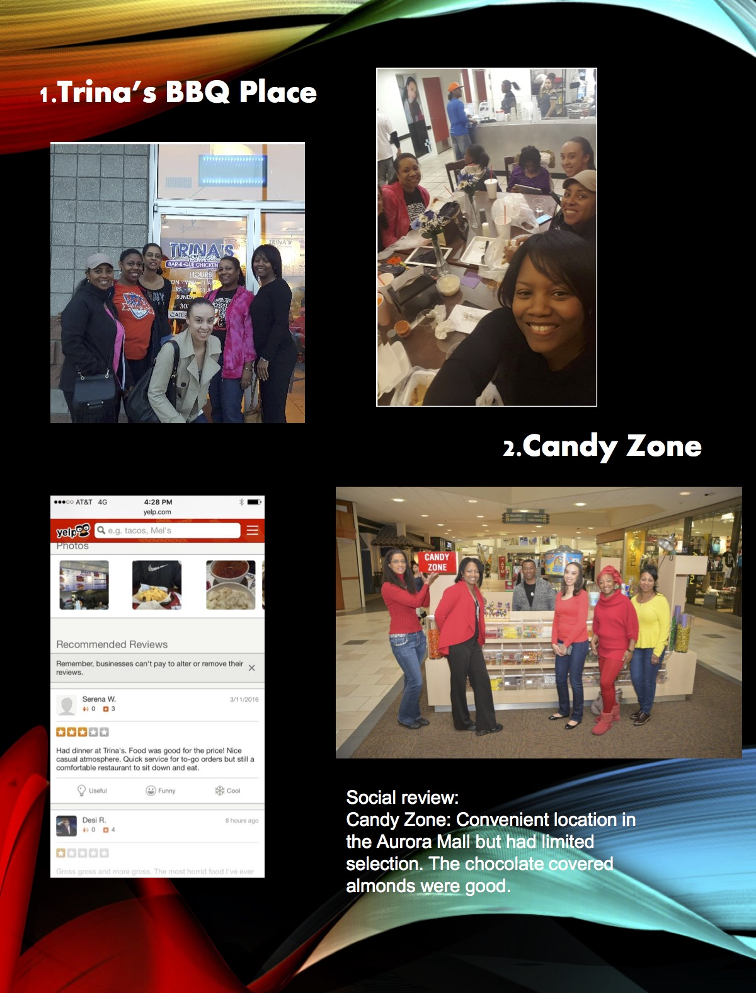

Slide 16
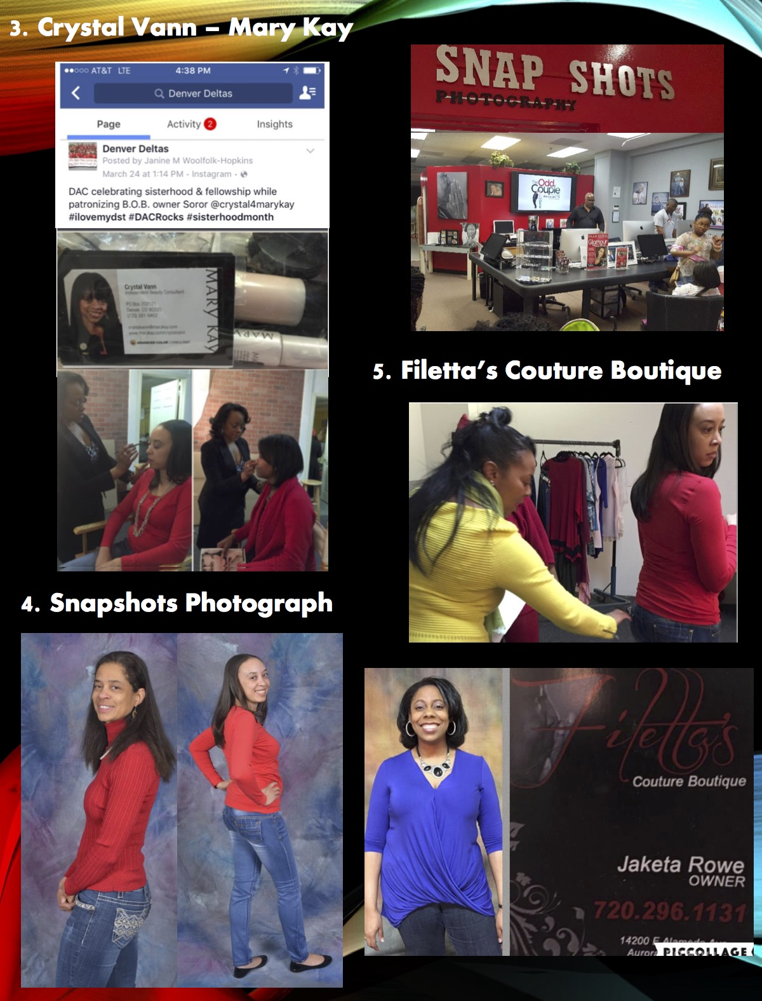

Slide 17
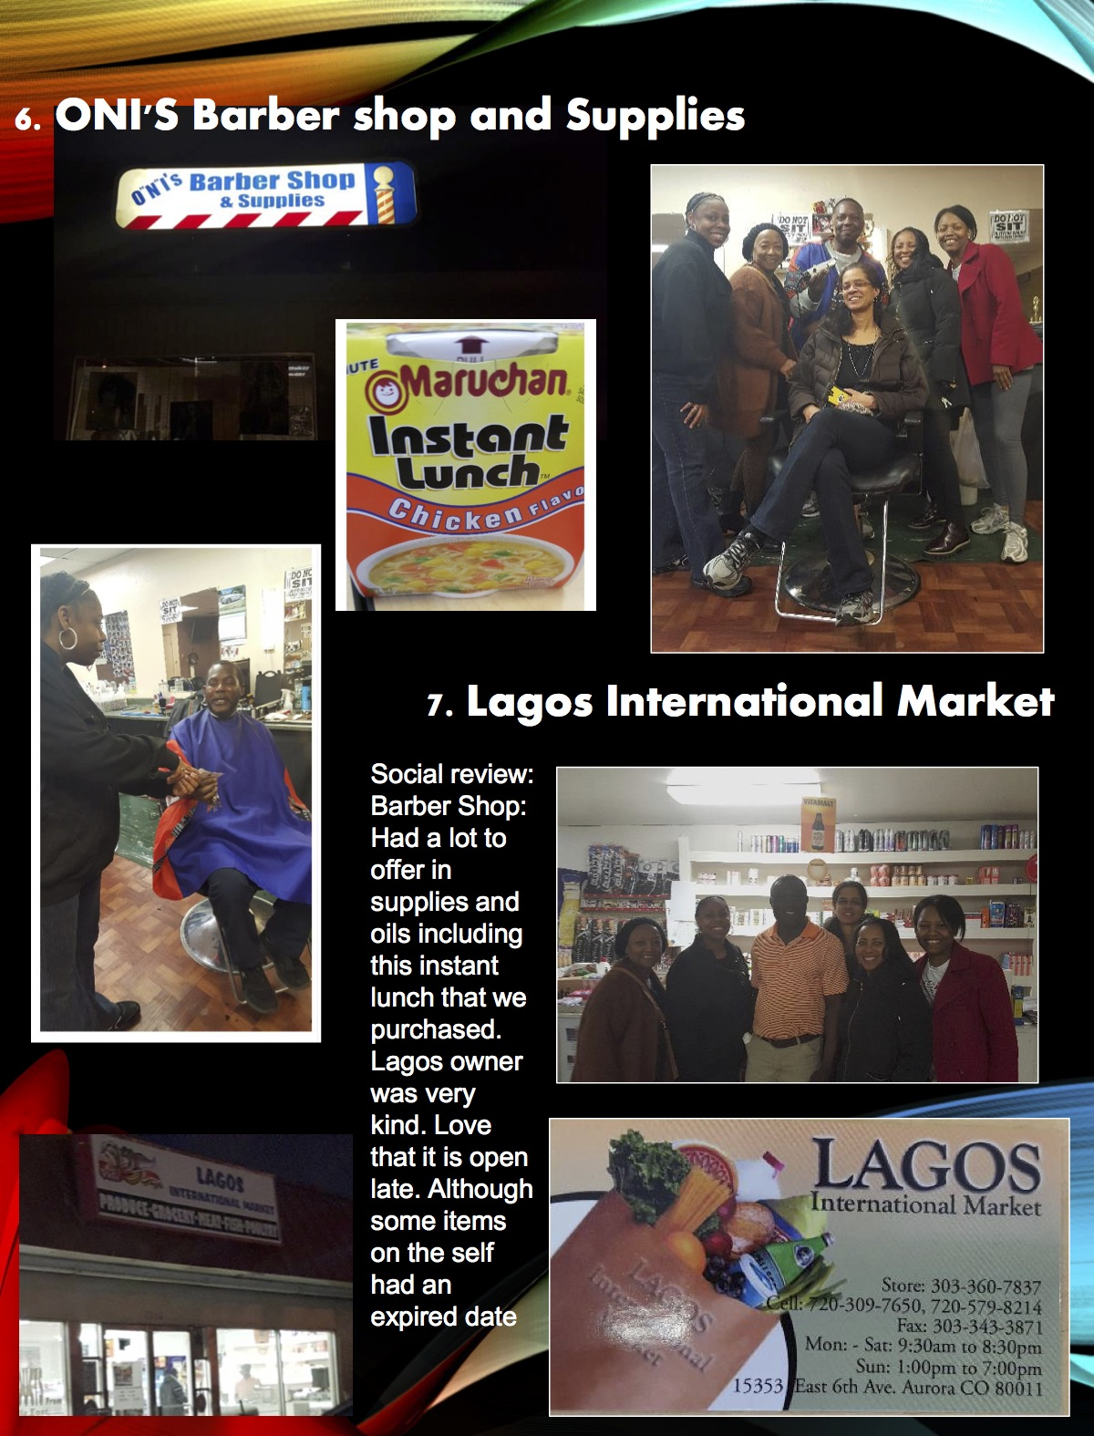

Slide 18
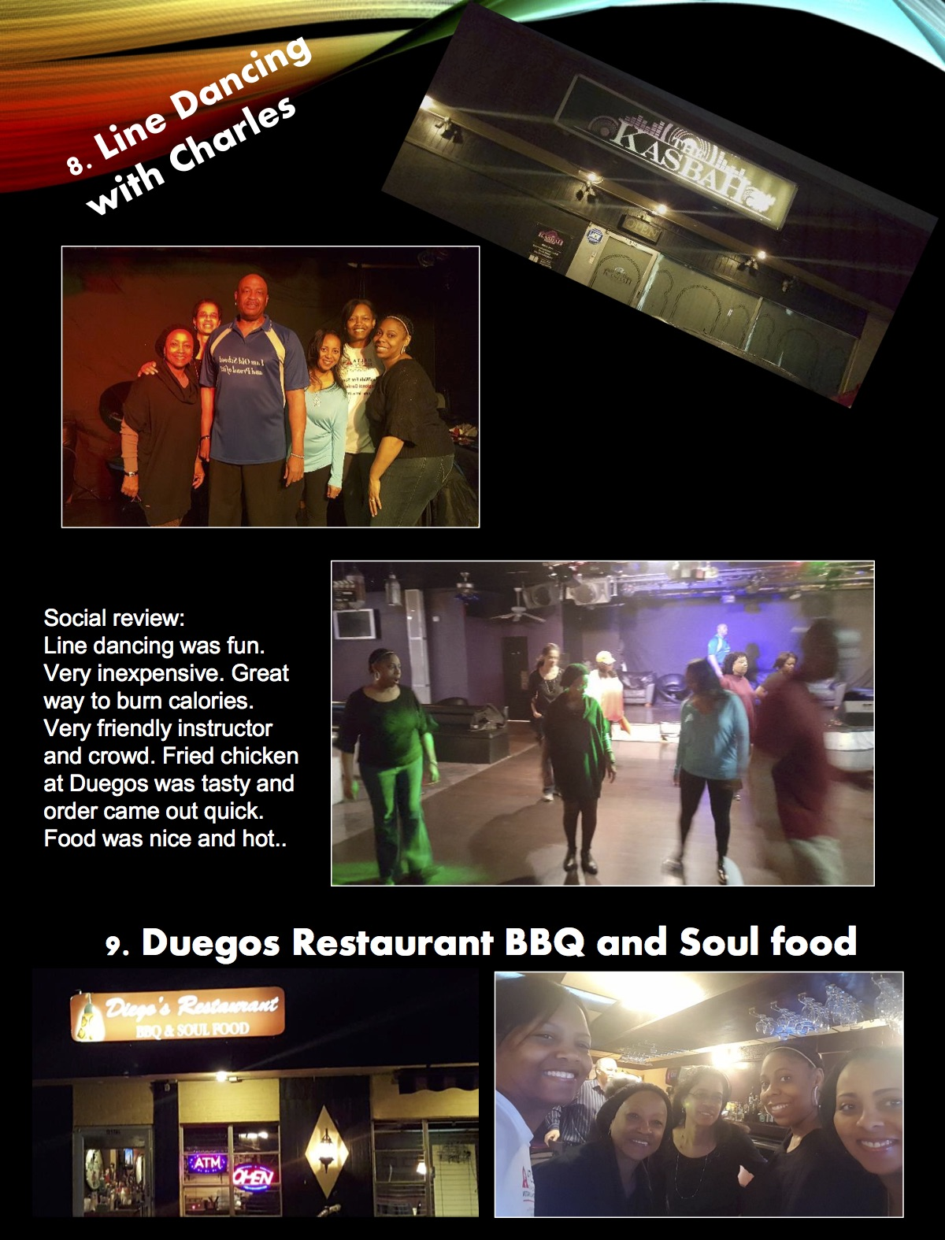

Slide 19
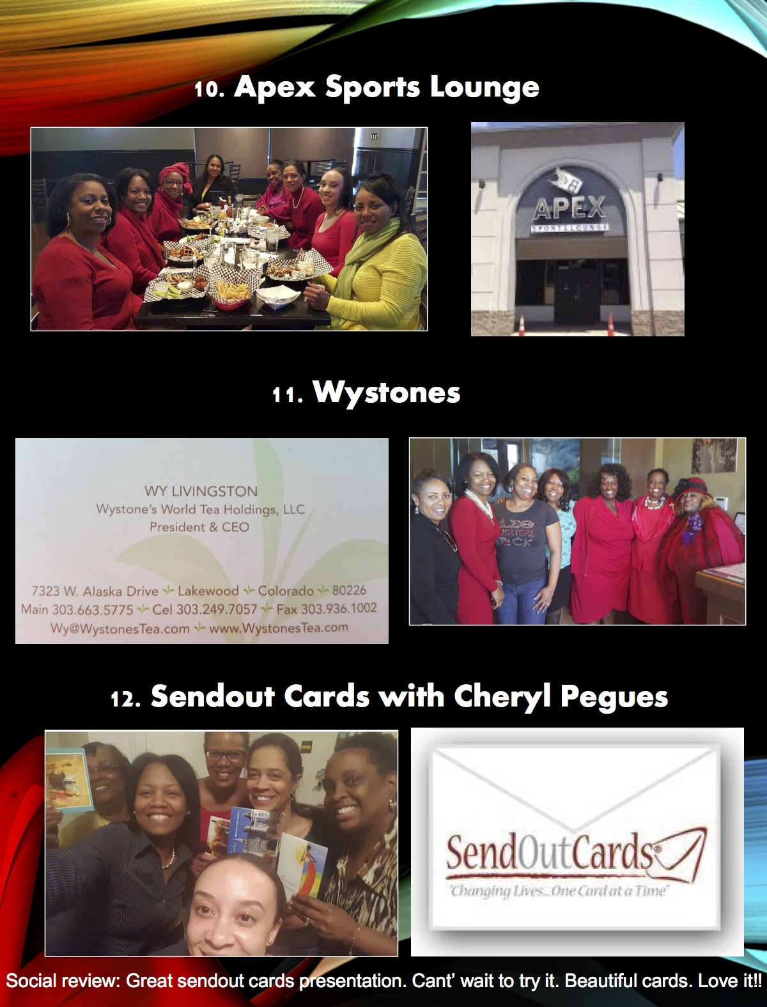

Slide 20
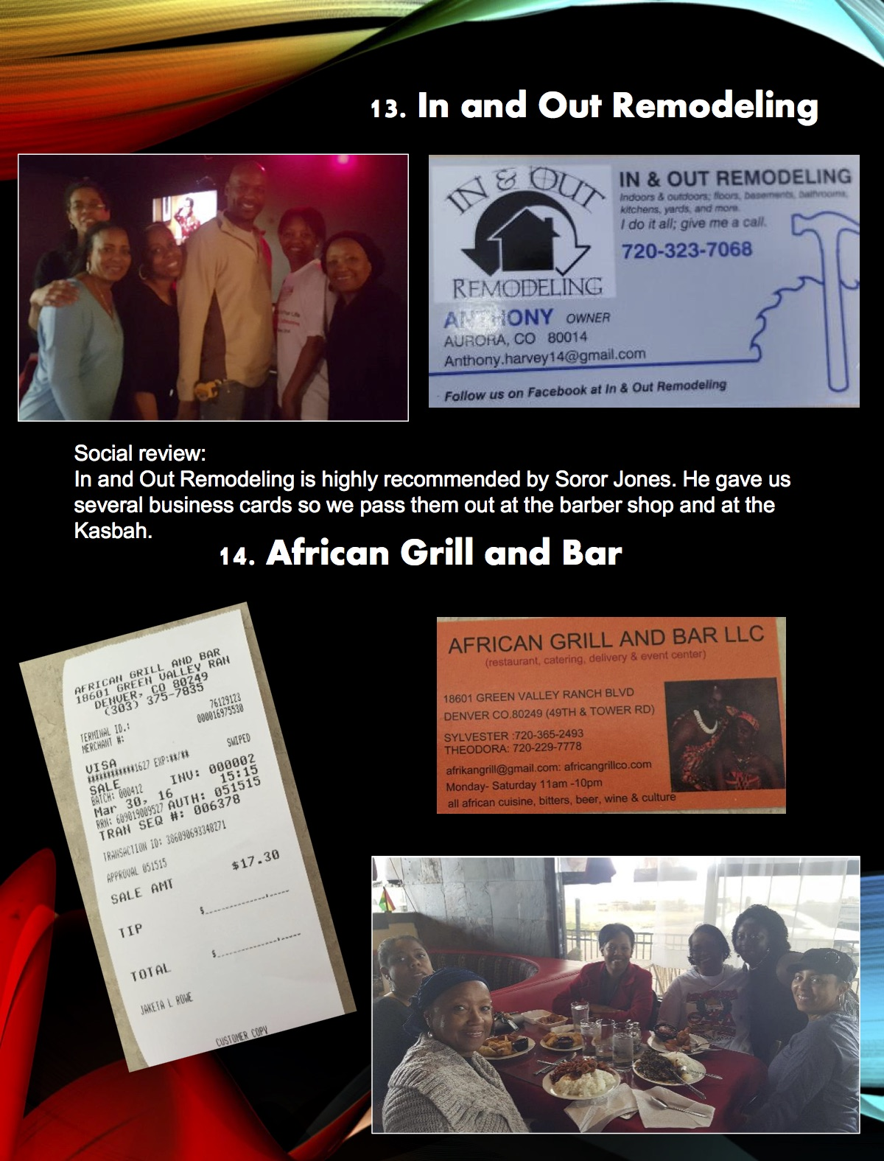

Slide 21


Slide 22
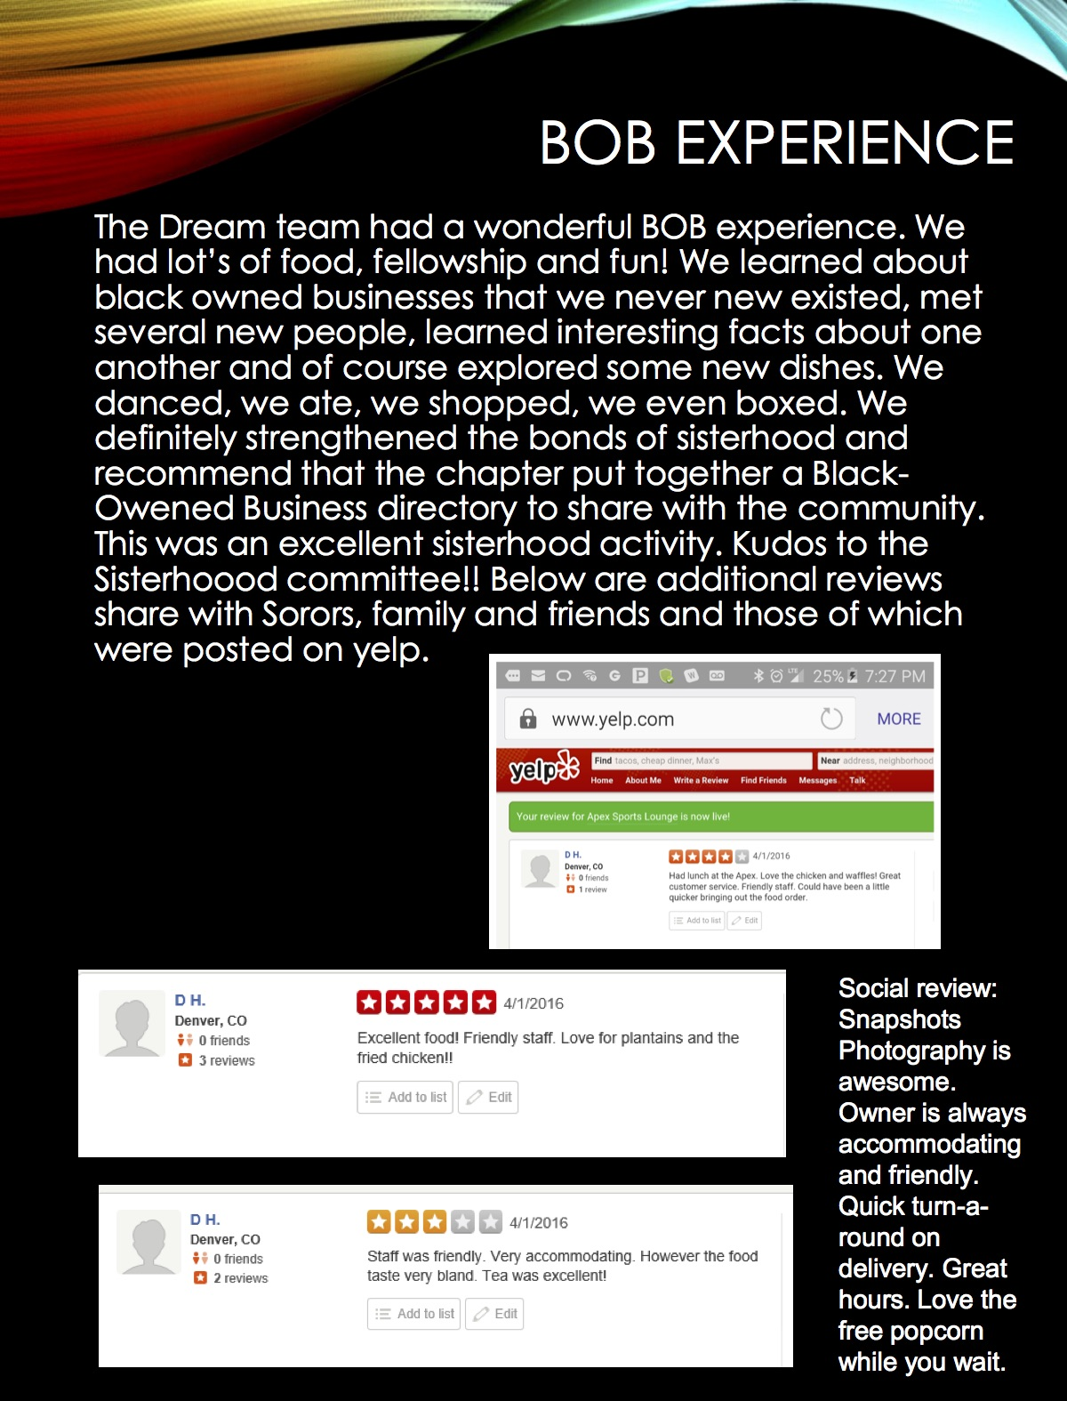

Slide 23


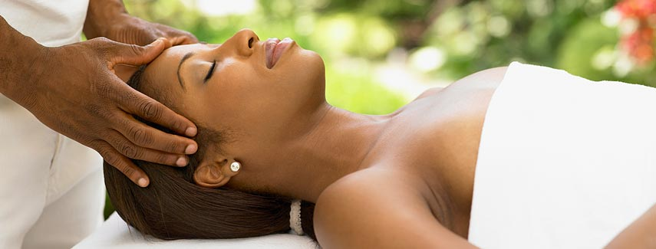
The Winning Team Receives….
Personalized massages!
Catered food and desserts!!
Fellowshipping and more!!!
With services and products provided by ‘Black Owned Business’

Slide 24

The Dream Team
!!!

Slide 25
The Sisterhood Committee thanks all of those who have participated in the BOB challenge that focused on supporting and promoting economic growth and empowerment within.
We further thank every Soror who has participated in the various activities throughout the years.
With Service and Love
Your Sisterhood Committee

